Slide 1

Linear Algebra for Machine Learning: Vector Embeddings
Mina Farmanbar
Associate Professor, University of Stavanger
for engineers

Slide 2
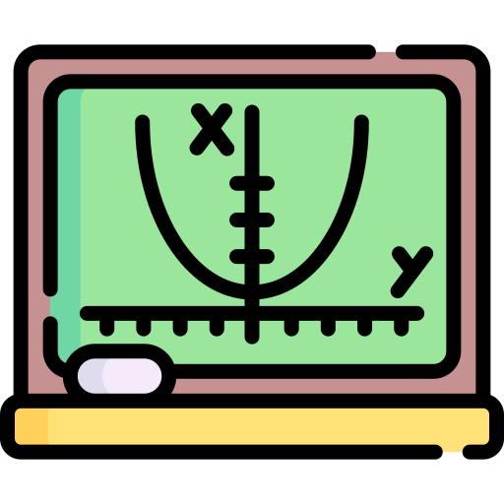

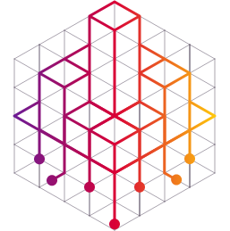

Vector Embedding
Linear Algebra
Data Representation
Vector Embedding
Dimensionality Reduction

Slide 3
Vector Embeddings
Vector embeddings are a way to represent objects, such as words or images, as vectors in a continuous vector space.
These embeddings capture the semantic meaning of the objects such that similar objects are close to each other in this space.

Slide 4


Vector Embeddings
Idea:
An embeddings of a vector is another vector in a smaller dimensional space.
$$\left[\begin{aligned}∗ \\ \begin{aligned}∗ \\ ∗\end{aligned}\end{aligned}\right]$$
$$\left[\begin{aligned}∗ \\ ∗\end{aligned}\right]$$
Replace
with

Slide 5
How to find embeddings?
Here are two ways:
Vector factorizations
Neural networks

Slide 6
Vector Factorization
Let´s talk about Matrices first…

Slide 7
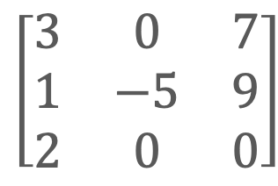
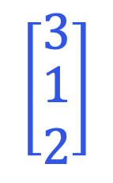
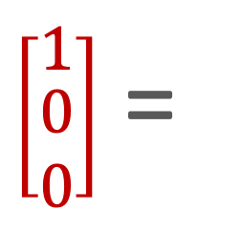
Matrices
Matrices are as fundamental as vectors in machine learning.
A matrix is a 2-dimensional array of numbers.
It represents a particular process of turning one vector into another: Stretching, rotating, scaling, or something more complex.
$\left[\begin{matrix}3 & 0 & 7 \\ 1 & −5 & 9 \\ 2 & 0 & 0\end{matrix}\right]$
$\left[\begin{aligned}1 \\ \begin{aligned}0 \\ 0\end{aligned}\end{aligned}\right]$ =
$$\left[\begin{aligned}3 \\ \begin{aligned}1 \\ 2\end{aligned}\end{aligned}\right]$$
*
Input
Output

Slide 8
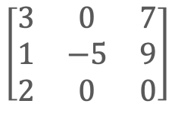
More generally…
A matrix represents a transformation of an entire vector space to another (possibly of different dimensions)
$$\left[\begin{matrix}3 & 0 & 7 \\ 1 & −5 & 9 \\ 2 & 0 & 0\end{matrix}\right]$$
Before
After

Slide 9
What is the matrix factorization?
Earlier, we were talking about multiplication:
We can take two numbers, multiply them, and get another number.
We can take two vectors, multiply them, and get another number.

Slide 10
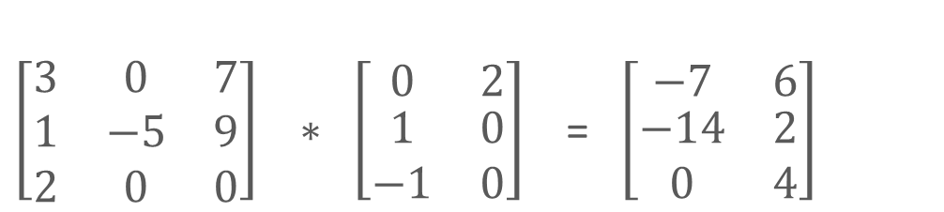
What is the matrix factorization?
Now:
We can take two matrices, multiply them, and get a matrix
$\left[\begin{matrix}3 & 0 & 7 \\ 1 & −5 & 9 \\ 2 & 0 & 0\end{matrix}\right] ∗ \left[\begin{matrix}0 & 2 \\ \begin{aligned}1 \\ −1\end{aligned} & \begin{aligned}0 \\ 0\end{aligned}\end{matrix}\right]$ = $\left[\begin{matrix}−7 & 6 \\ \begin{aligned}−14 \\ 0\end{aligned} & \begin{aligned}2 \\ 4\end{aligned}\end{matrix}\right]$
3 x 3
3 x 2
3 x 2
Sizes must match

Slide 11
Multiplication can be “undone”
This is called factorization.
Multiplication
12 x 3 x 5 540
Factorization

Slide 12
Matrices can also be factored
Multiplication
*
*
Factorization

Slide 13
In general, factorization is hard
Multiplying numbers is easier than trying to factor them.
Modern cryptography is based on the difficulty of factorization.
There is a nice result for matrices:
Every matrix can be factored!
This is a fundamental theorem in linear algebra.

Slide 14
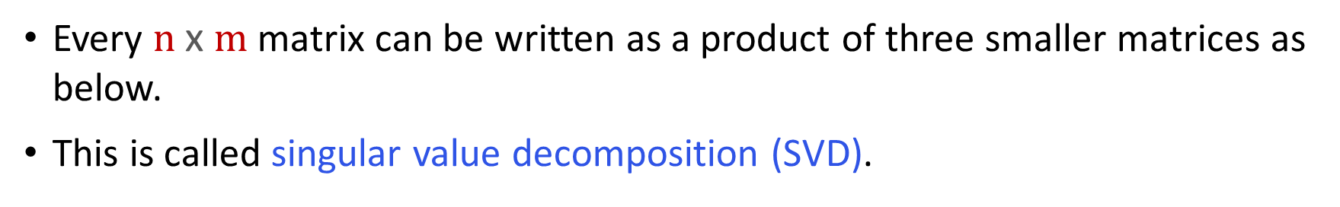

Singular Value Decomposition
Every $n \text{x} m$matrix can be written as a product of three smaller matrices as below.
This is called singular value decomposition (SVD).
Columns are “orthonormal”
Diagonal
matrix
Rows are “orthonormal”
$$=$$
*
*
M
n x m
U
n x k
D
k x k (k = rank of M)
V⏉
k x m

Slide 15
Singular Value Decomposition
So not only it is a fundamental result of linear algebra, but it also appears in lots of places, not just machine learning:
Statistics (Principal Component Analysis)
Chemical physics
Image Processing
Robotics
Data Embeddings/ Vector Embeddings

Slide 16
How do matrix factorizations give us vector embeddings?
How do matrix factorizations give us
vector embeddings??

Slide 17

The answer is:
The columns/rows of the factors are candidates for embeddings.
1 2 3 4 5
1 2 3 4 5
1 2
3 4
1 2
3 4
$$=$$
*
*

Slide 18

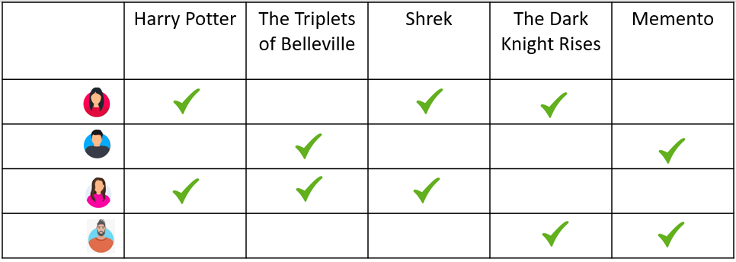
The answer is:
Imagine a user-by-movie matrix obtained by stacking users’ data vectors side by side (checkmarks are 1s and empty cells are 0s or negatives.)

Slide 19
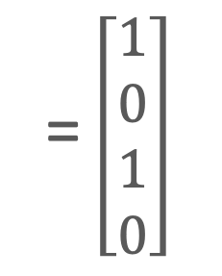
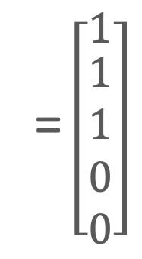
The answer is:
For example, I can represent user number 3, that third row, by a vector namely just corresponding to the entries in that third row.
= $\left[\begin{aligned}1 \\ \begin{aligned}1 \\ 1 \\ 0 \\ 0\end{aligned}\end{aligned}\right]$
= $\left[\begin{aligned}1 \\ 0 \\ 1 \\ 0\end{aligned}\right]$
User 3
Shrek

Slide 20
There are features in the data:
Some users are kids, others are adults.
Some movies are for kids, others are for adults.
Some movies are blockbusters, others are arthouse movies.
10 years old
35 years old
16 years old
42 years old

Slide 21
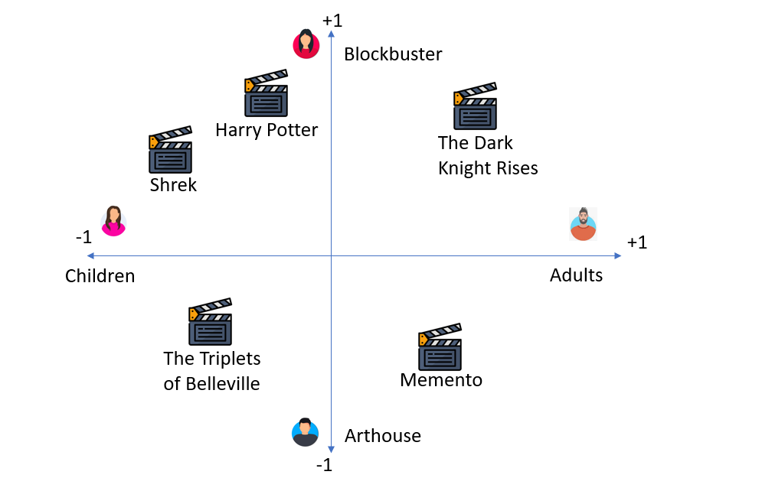
Goal
Find new, smaller-dimensional vector representations that capture these features.
For example, a 2-dimensional “latent” space.
10 years old
16 years old
42 years old
35 years old

Slide 22



How?
Use SVD-like techniques to find “smaller” matrices U and V whose product is close to the original matrix. Columns and rows of U and V are candidates for embeddings.
U
$$V^{T}$$
$$\sim$$
*
4 x 2
2 x 5

Slide 23
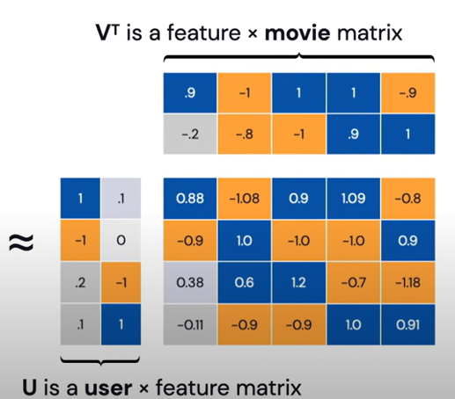
How?

Slide 24
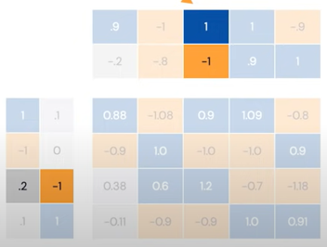


How?
= $\left[\begin{aligned}1 \\ \begin{aligned}1 \\ 1 \\ 0 \\ 0\end{aligned}\end{aligned}\right]$ >> $\left[\begin{aligned}0.2 \\ −1\end{aligned}\right]$
= $\left[\begin{aligned}1 \\ 0 \\ 1 \\ 0\end{aligned}\right]\text{>> }\left[\begin{aligned}1 \\ −1\end{aligned}\right]$
User 3
Shrek

Slide 25
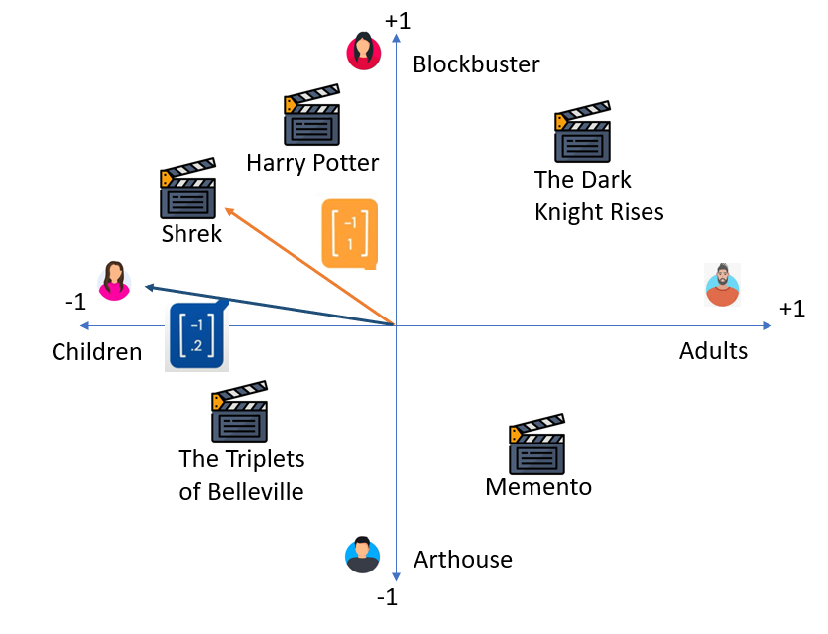
Goal
10 years old
These vectors are close.
In particular, the “shadow” of orange vector onto blue is pretty large. (Remember, the dot products is a measure of similarity)
16 years old
42 years old
35 years old

Slide 26

Neural Network
$$\left[\begin{matrix}0 \\ 0 \\ 0 \\ 0 \\ 0 \\ 0 \\ 0 \\ 1 \\ 0 \\ 0 \\ 1 \\ 0 \\ 0 \\ 0 \\ 0\end{matrix}\right]$$
Feed data vector into a neural network.
The output is vector embeddings.
$$\left[\begin{matrix}∗ \\ ∗ \\ ∗ \\ ∗ \\ ∗\end{matrix}\right]$$
Neural Network
Vector embedding
Movies viewed by user

Slide 27
Summary
In either case, the goal is the same.
“Compress” your high-dimensional data into a smaller dimensional, more meaningful subspace.
This should be done in a way that you don’t lose too much information.
This actually brings us to the larger discussion of dimensionality reduction technique.

Slide 28
Thank you!
Mina Farmanbar
mina.farmanbar@uis.no

